Slide 1



HEART DISEASE PREDICTION USING MACHINE LEARNING WITH PYTHON
Submitted to:
Dr. UMAMAHESWARAN
UDAY PARUCHURI -1NH21AI134
SAI VAMSI M -1NH21AI135
BABU DHANUSH KUMAR M -1NH21AI144
21AIM38A-Mini Project I

Slide 2
Introduction
Objectives
Literature Survey
Proposed Systems
System Designs
Implementation
Results
Conclusion
Future Enhancement
CONTENTS
21AIM38A-Mini Project I

Slide 3
Introduction
Heart disease is a major global health issue and early prediction of the disease can greatly improve patient outcomes.
Machine learning techniques have shown promise in predicting the onset of heart disease and providing risk assessments.
In a typical heart disease prediction system using machine learning, patient data such as age, blood pressure, cholesterol levels, and other medical history are collected and used as input features. These features are fed into a machine learning model which is trained on a large dataset of heart disease patients.
21AIM38A-Mini Project I

Slide 4
Objectives
The main objective of this project is to develop a heart disease prediction system, that can predict heart disease from heart data set.
This system aims to exploit machine learning techniques on medical data set to assist in the prediction of the heart disease.
Reduces the cost of medical tests.
If this information is predicted well in advance, can provide important insights to doctors who can then diagnose and treat the patient.
21AIM38A-Mini Project I

Slide 5
Literature Survey
S.NO | ARTICLE NAME | Author Name | PUBLISHED YEAR | REMARKS
1 | Prediction of Heart Disease Using Machine Learning Techniques: A Review | Jyoti Soni and Naveen Hemrajani | 2019 | This is a comprehensive review of various machine learning techniques used for heart disease prediction. The paper provides a comparison of different algorithms and highlights their strengths and weaknesses.
2 | Prediction of Heart Disease using Machine Learning Algorithms | S. S. Mundhe and S. R. Sonawane | 2018 | This paper presents a comparative study of various machine learning algorithms for heart disease prediction, including decision trees, k-NN, SVM, and ANN. The authors also discuss the importance of data preprocessing and feature selection in improving the accuracy of the models.
3 | Machine learning for heart failure outcome prediction: A systematic review | Xuehan Xu | 2020 | This paper provides a systematic review of studies that have used machine learning algorithms for heart failure outcome prediction. The authors summarize the key findings of these studies and highlight the strengths and limitations of different machine learning algorithms for heart failure outcome prediction.
21AIM38A-Mini Project I

Slide 6
Proposed System
Data collection: Obtain a dataset containing patient information, such as age, gender, medical history, resting blood pressure, fasting blood sugar and other factors.
Data pre-processing: Clean and pre-process the data to handle missing or incorrect values, remove outliners, and perform any necessary transformations.
Choose a machine learning algorithm: Choose an algorithm that is well suited for binary classification problems, such as logistic regression.
Train the model: Use the data to train the machine learning model.
21AIM38A-Mini Project I

Slide 7
Splitting
Training Data
Training (Logistic Regression)
Testing Data
Classifier
Preprocessing
Input Data
Normal
Abnormal
21AIM38A-Mini Project I

Slide 8
System Designs
Hardware Requirements
Software Requirements
OS Windows 7 or Later
Google Colab & Jupyter Notebook
Various Libraries and frameworks such as TensorFlow or scikit-learn.
Python Programming Language.
Processor: Intel i3/i5 or Higher.
RAM: 6GB or More.​
Hard Disk: 8GB recommended for primary partition
21AIM38A-Mini Project I

Slide 9
Data Collection
Age
Sex : The person’s sex (1=male, 0=female)
cp: Chest-pain type (— Value 0: asymptomatic, Value 1: atypical angina, Value 2: non - anginal pain, Value 3: typical angina)
trtbps :Resting blood pressure
chol : Serum cholesterol:
fbs : Fasting blood sugar
restecg : Resting ECG (Electro Cardio Graphy)
thalachh : Max heart rate achieved
exng : Exercise induced angina
oldpeak : ST depression induced by exercise relative to rest
slp : Slope of the peak
caa : Number of major vessels colored by fluoroscopy (0–3)
thall : Defect type (Value 0: NULL (dropped from the dataset previously, Value 1: fixed defect (no blood flow in some part of the heart), Value 2: normal blood flow Value 3: reversible defect (a blood flow is observed but it is not normal)
21AIM38A-Mini Project I

Slide 10
What is the Algorithm used for this model ?
The algorithm used in this model is Logistic Regression is one of the machine learning algorithm
Logistic regression is one of the most popular Machine Learning algorithms, which comes under the Supervised Learning technique. It is used for predicting the categorical dependent variable using a given set of independent variables
The algorithm results category of 1 and 0 for presence and absences of cardiac disease.
21AIM38A-Mini Project I

Slide 11
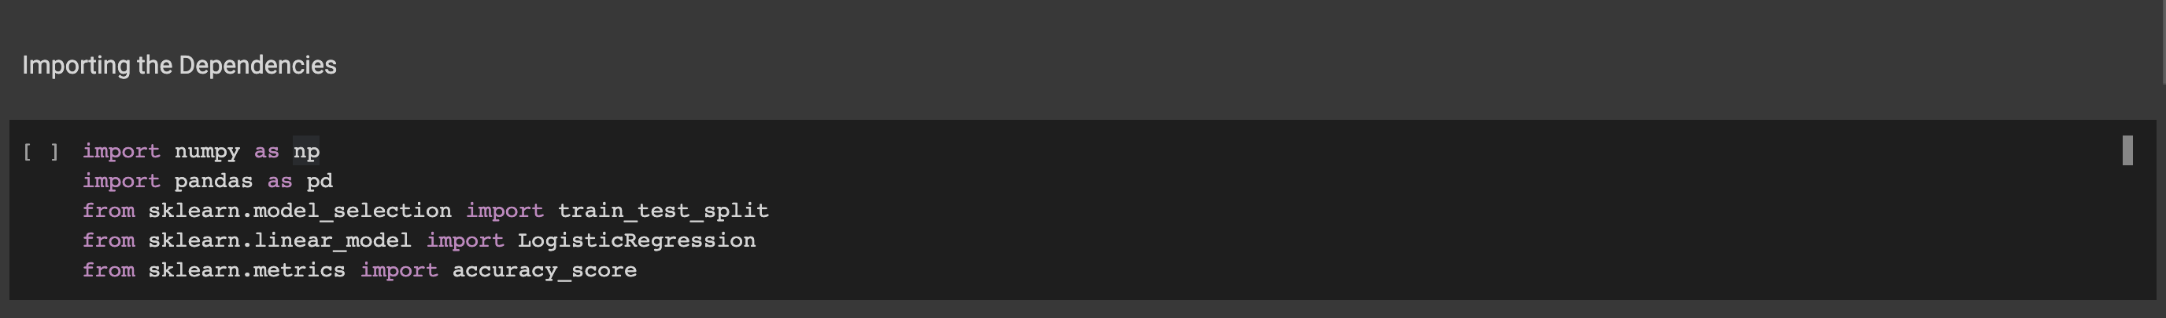
Implementation
21AIM38A-Mini Project I

Slide 12
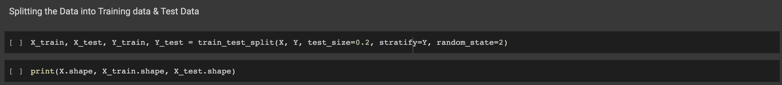
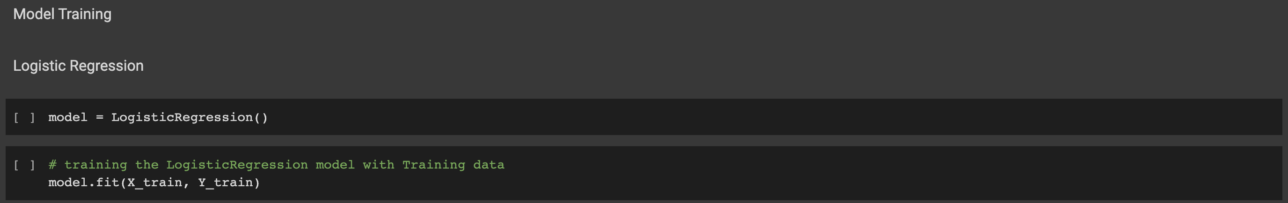
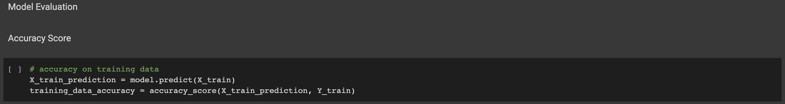
21AIM38A-Mini Project I

Slide 13
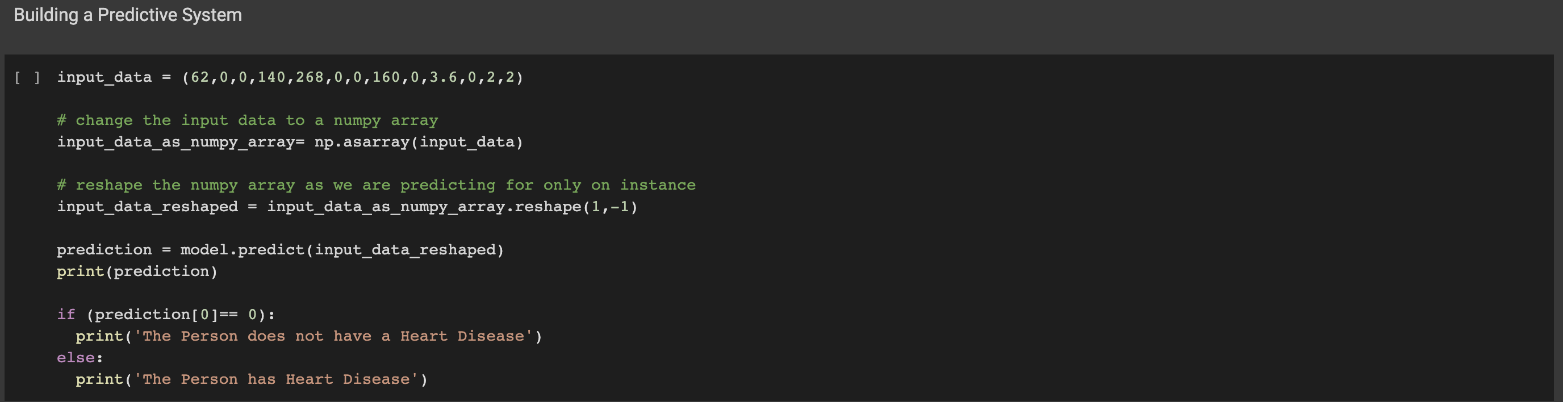
21AIM38A-Mini Project I

Slide 14
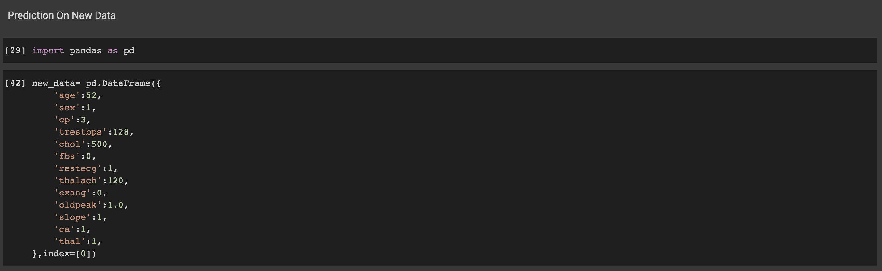
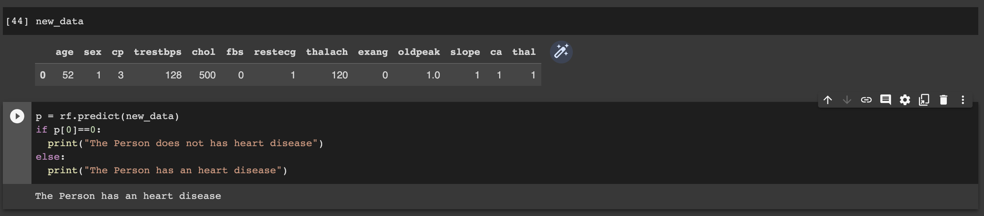
21AIM38A-Mini Project I

Slide 15
Result
21AILM38A-Mini Project I

Slide 16
Future Enhancement
Long-term monitoring: Currently, machine learning models for heart disease prediction are trained on data collected at a single point in time. By incorporating long-term monitoring data, predictions could be made based on changes in a patient's health over time.
Active Learning: Active learning is a technique where the machine learning algorithm actively seeks out the most informative data to train on, rather than relying solely on pre-existing data. This can lead to improved predictions over time, as the algorithm becomes more knowledgeable about the specific population it is working with.
Improved Data Collection: Currently, heart disease prediction models are trained on limited data sets. By increasing the size and diversity of data sets, machine learning models can be trained on a more comprehensive set of information and make more accurate predictions.
21AIM38A-Mini Project I

Slide 17
Conclusion
In conclusion, heart disease prediction using machine learning has the potential to revolutionize the way that we diagnose and treat heart disease. Machine learning algorithms can analyze vast amounts of data and identify patterns and relationships that would be difficult for humans to detect. This can lead to earlier and more accurate diagnoses of heart disease, as well as personalized treatment plans that take into account a patient's unique risk factors.
Overall, heart disease prediction using machine learning holds great promise for improving the health outcomes of patients and reducing the burden of heart disease on society. By continuing to invest in this area of research and development, we can work towards a future where heart disease is detected and treated more effectively and efficiently.
21AIM38A-Mini Project I

Slide 18
THANK YOU
21AIM38A-Mini Project I

